Slide 1

What Data Science Skills Are Most Valued?
Jennifer Abinette
Avery Davidowitz

Slide 2

Approach
Analyze Job Listings for Data Scientist positions in the United States to find the skills most frequently referenced which will be considered the most valued for a Data Scientist
We will further analyze how many skills are included per job listing and explore if job listings for larger cities reference more skills than smaller cities.

Slide 3



Data Sources
U.S. Population by City
dataset retrieved from census.gov
U.S. State Abbreviations
dataset retrieved from usps.gov
U.S. Data Scientist Job Listings
6,953 data scientist job listings scraped from Indeed.com in 2018 and posted for use on Kaggle.com. We filtered out positions that did not include ‘data’ in the position name leaving 2,079 before importing into R.
List of Data Science Skills
dataset created based on 1st page of Google Search results of Data Scientist Skills
Github Repository: https://github.com/JAbinette/CUNY-607-Project-3-Data-Science-Skills

Slide 4
Methodology
Load datasets from Github Repository into R
Tidy/Transform in R
Load into Google Cloud MySQL Database
Conduct analyses in R

Slide 5
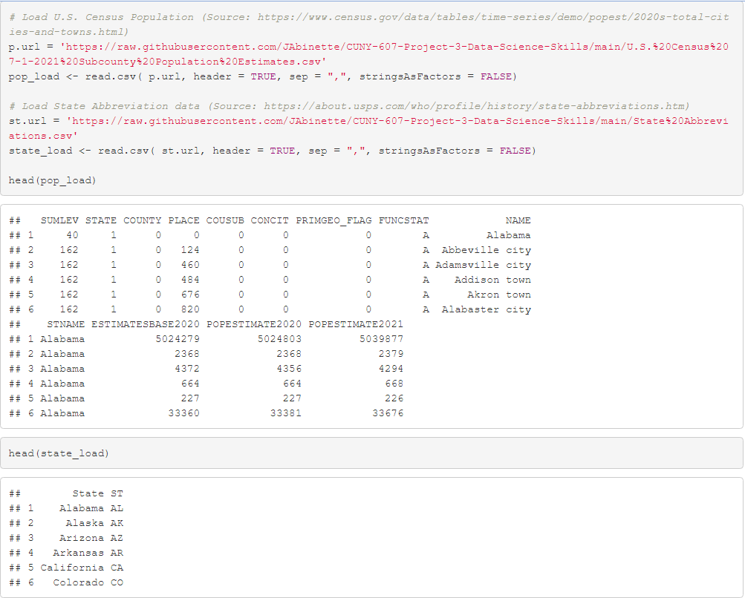
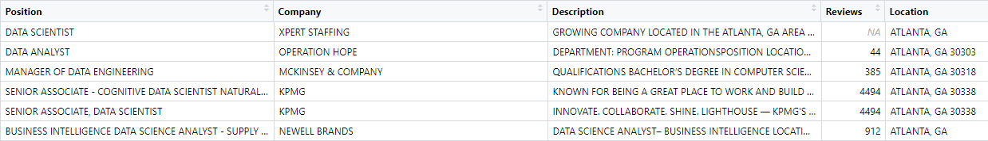
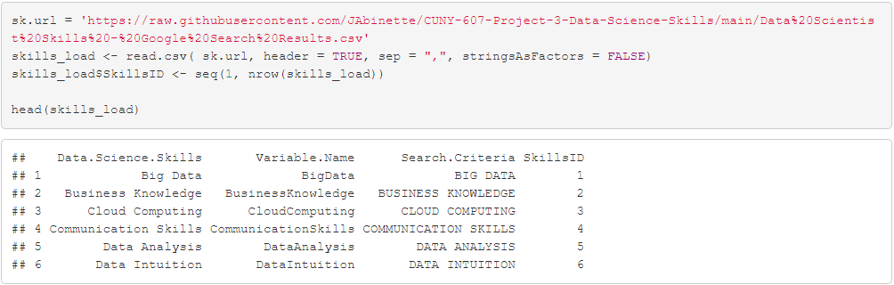
Load Datasets from Github
url = ‘https://wherever file is saved.csv’
Data <- read.csv (url, HEADER=TRUE, sep=“,”, stringsAsFactors = FALSE)

Slide 6
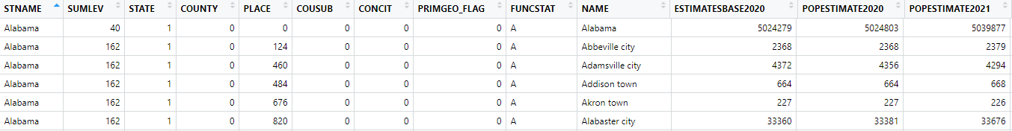


Tidy Transform
U.S. Census Population Dataset

Slide 7
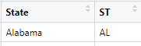

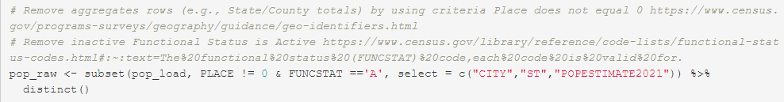

U.S. Census Population Dataset
State Abbreviations Dataset
Merge
Create City Variable
Remove Aggregate Rows
Remove Inactive Locations
Assign Location ID

Slide 8
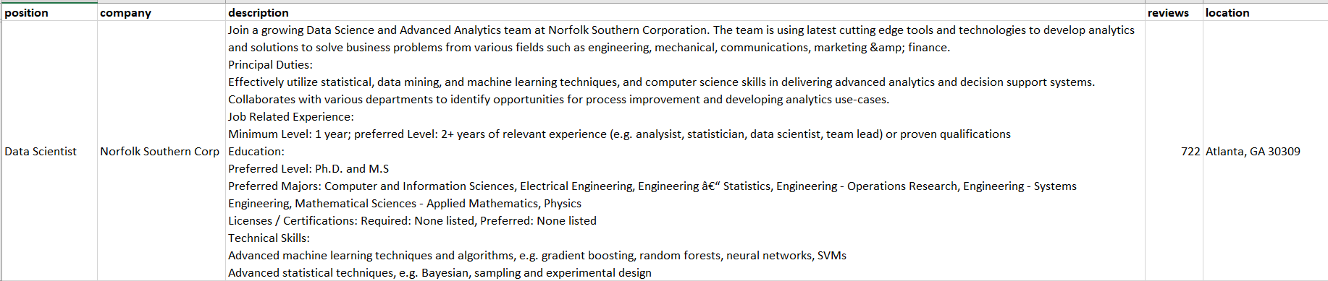

Tidy Transform
U.S. Job Listings

Slide 9
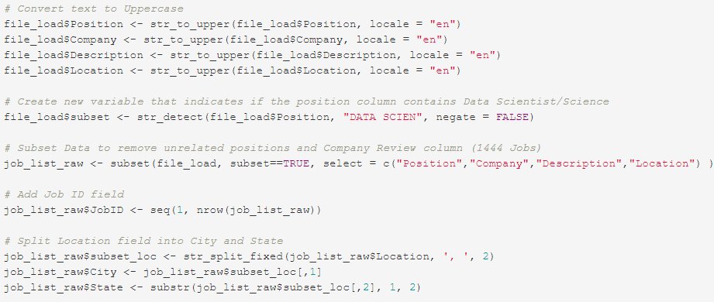
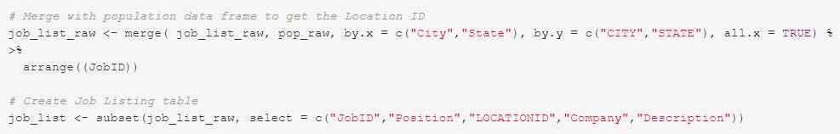

Slide 10
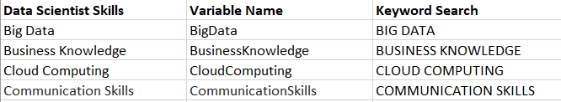
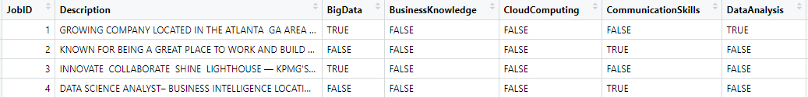
Tidy Transform
Job Listings
Skills List

Slide 11
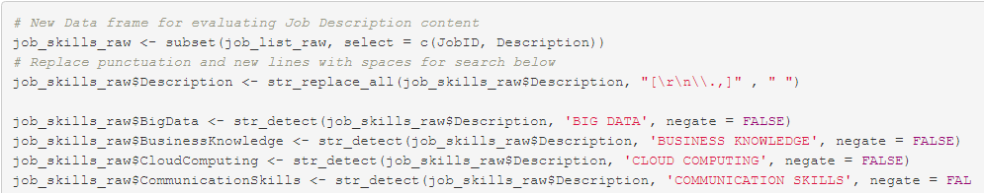

Slide 12


Load into Google Cloud

Slide 13
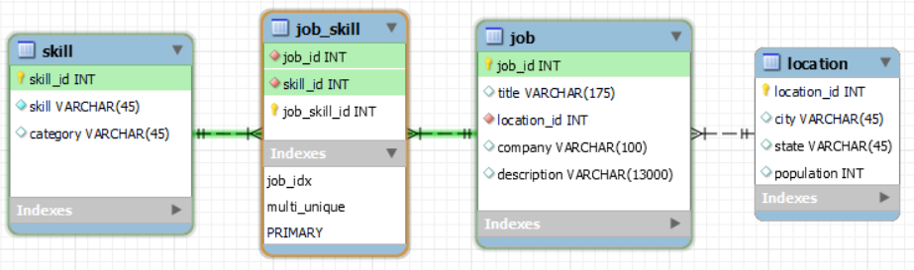
Database Model
MySQL Workbench
Schema
ER Diagram
Export SQL Create Script

Slide 14
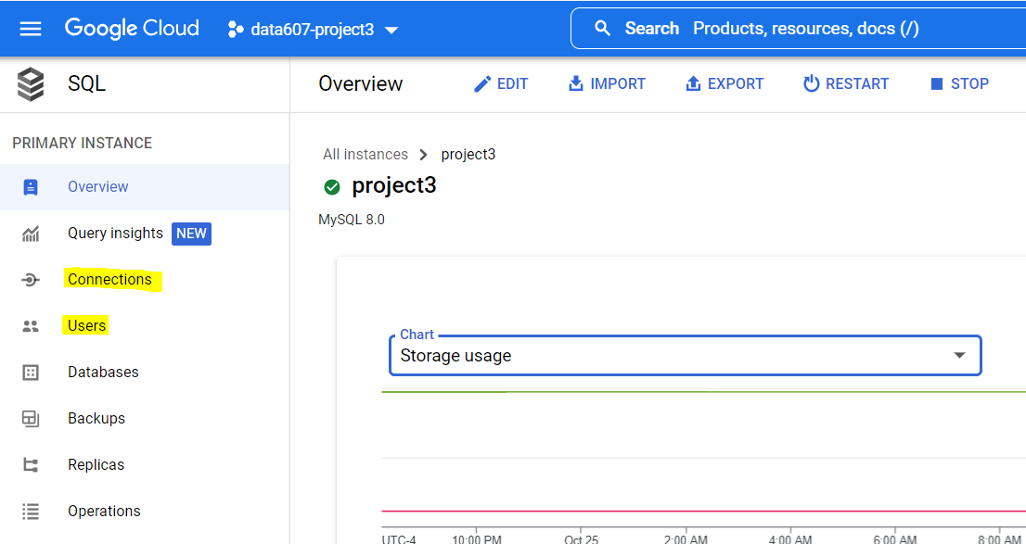
Google Cloud MySQL Instance
Connections
Users

Slide 15
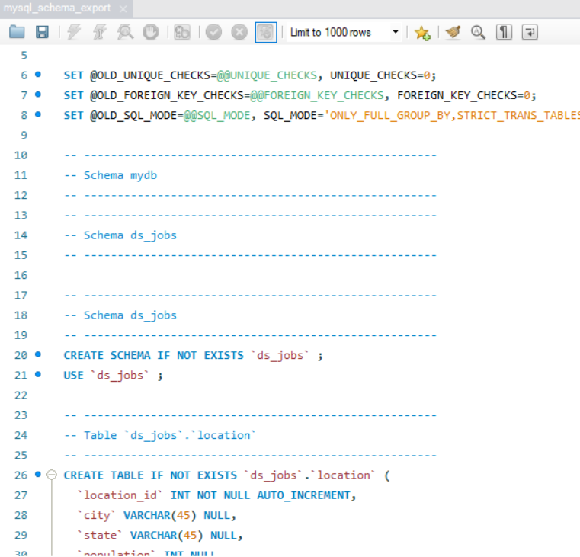
Create Script

Slide 16
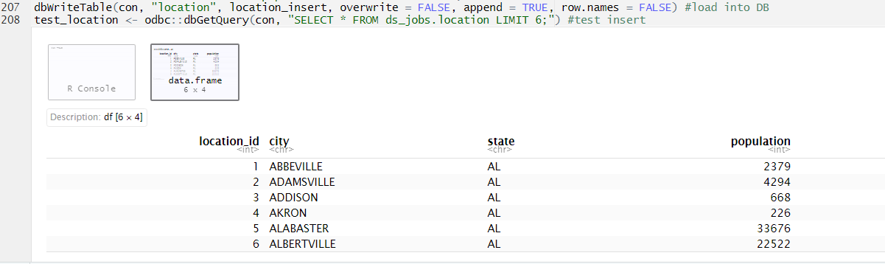
Load Dataframes to Database
dbWriteTable
dbGetQuery

Slide 17
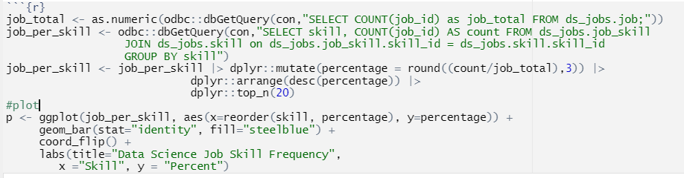
Analysis
Query from Database
as.numeric
dbGetQuery
Create
Top 20
mutate
arrange
top_n
Plot with ggplot
ggplot
geom_bar

Slide 18
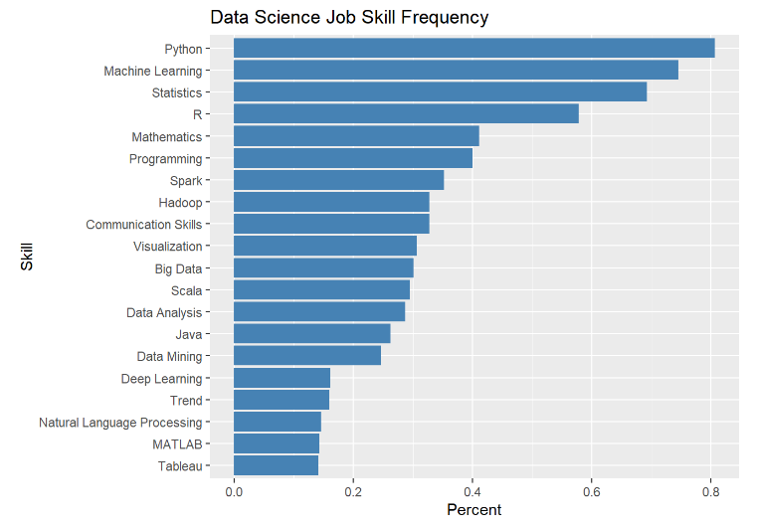
What are the Top 20 Job Skills?

Slide 19
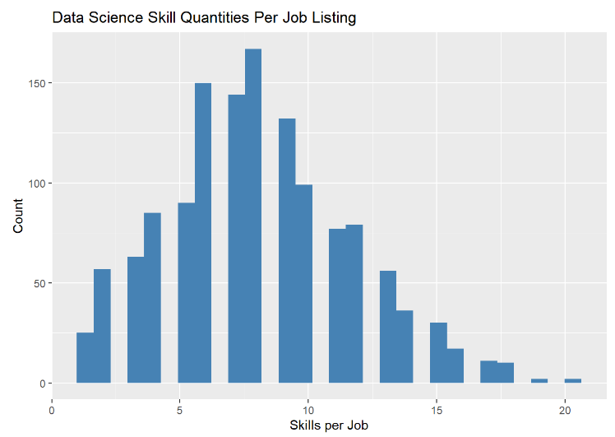
How many skills are included per job listing?

Slide 20
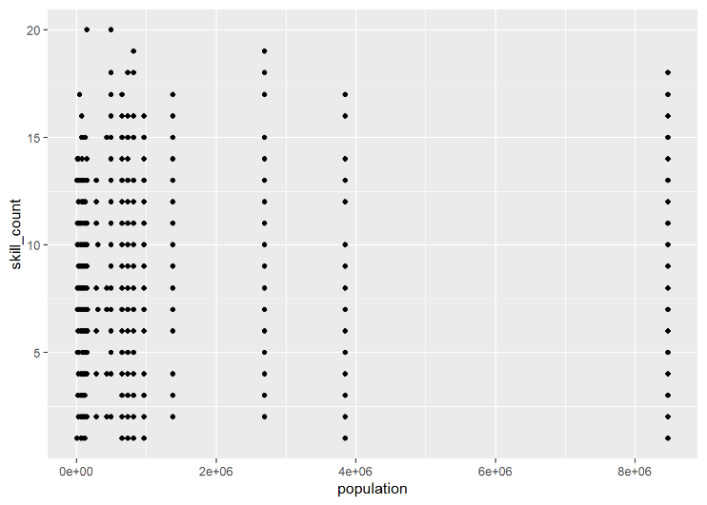
Does the number of skills per job vary by population of the job location?

